Slide 1


Slide 2
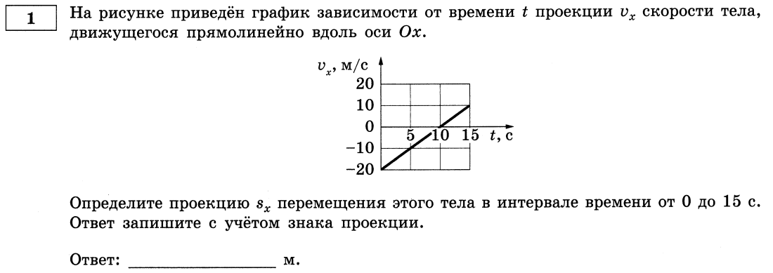
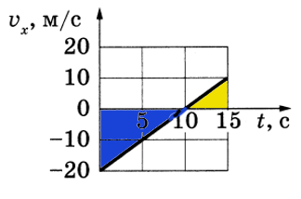

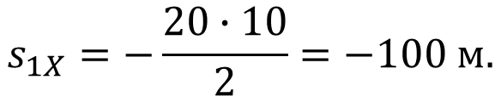
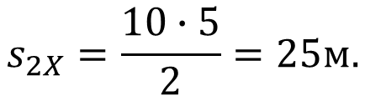




$$S_{2x}>0$$
$$S_{1x}<0$$
$$s_{1X}=−\frac{20∙10}{2}=−100 м.$$
$$−75$$
$$s_{2X}=\frac{10∙5}{2}=25м.$$
$$\vec{S}$$
$$S_{x}=S_{1x}+S_{2x}=−100+25=−75 м.$$

Slide 3
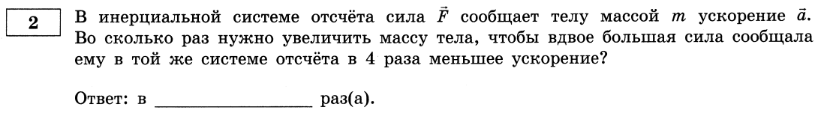


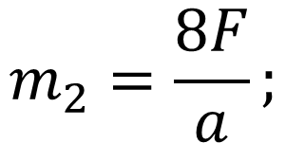
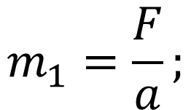
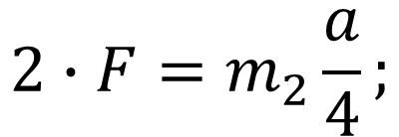
$$8$$
$$m_{1}=\frac{F}{a};$$
$$F=m_{1}a;$$
$$2∙F=m_{2}\frac{a}{4};$$
$$m_{2}=\frac{8F}{a};$$

Slide 4
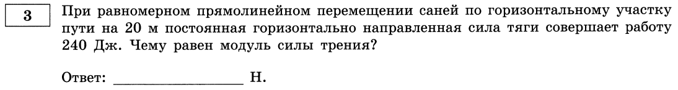
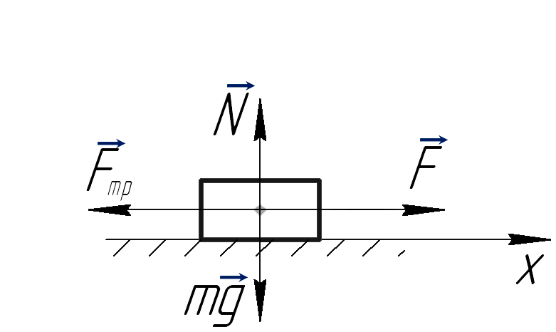

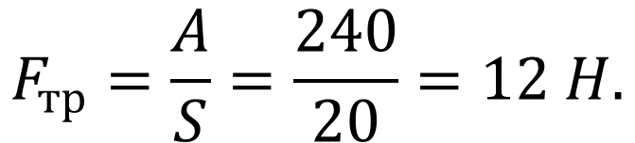

$$12$$
$$A=FScosα=FS: cos0^{o}=1;$$
$$F=F_{тр};$$
$$F_{тр}=\frac{A}{S}=\frac{240}{20}=12 H.$$

Slide 5
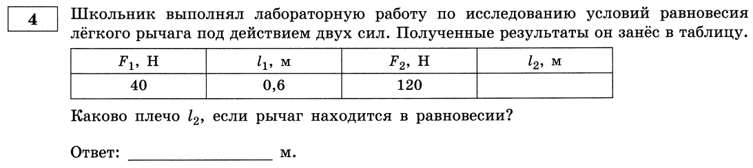


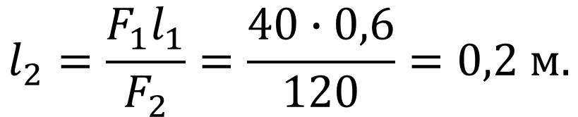
$$0,2$$
$$F_{1}l_{1}=F_{2}l_{2};$$
$$l_{2}=\frac{F_{1}l_{1}}{F_{2}}=\frac{40∙0,6}{120}=0,2 м.$$

Slide 6
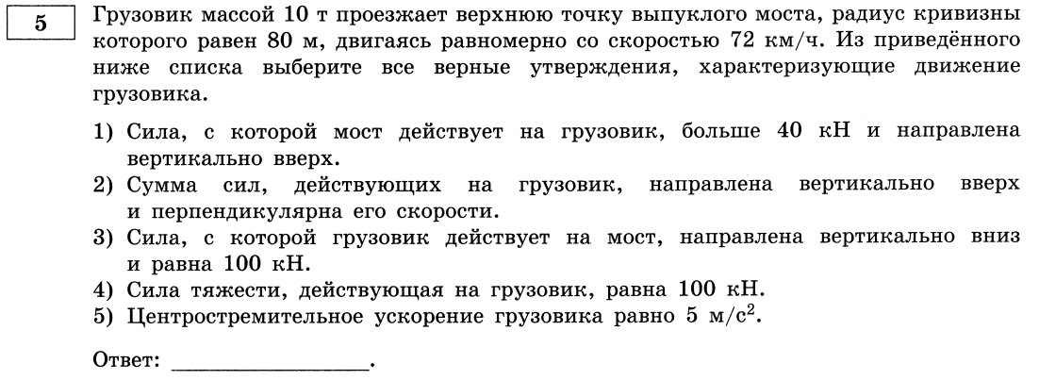


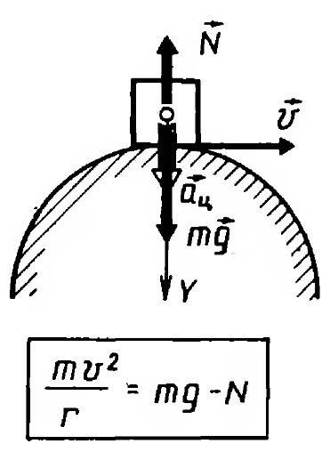
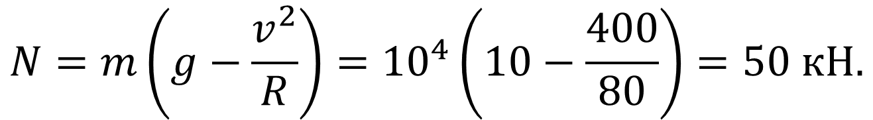
$$N=m\left(g−\frac{v^{2}}{R}\right)={10}^{4}\left(10−\frac{400}{80}\right)=50 кН.$$

Slide 7

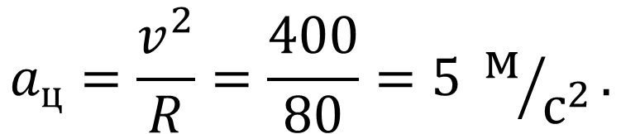
$$145$$
$$F_{т}=mg={10}^{4}∙10=100 кН.$$
$$a_{ц}=\frac{v^{2}}{R}=\frac{400}{80}=5 м/{с^{2}}.$$

Slide 8
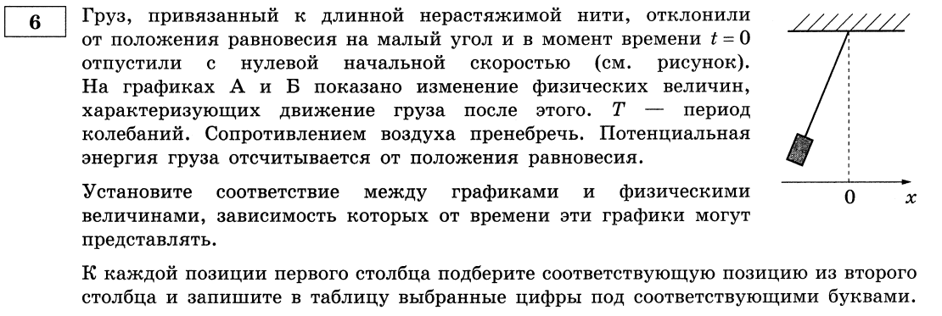
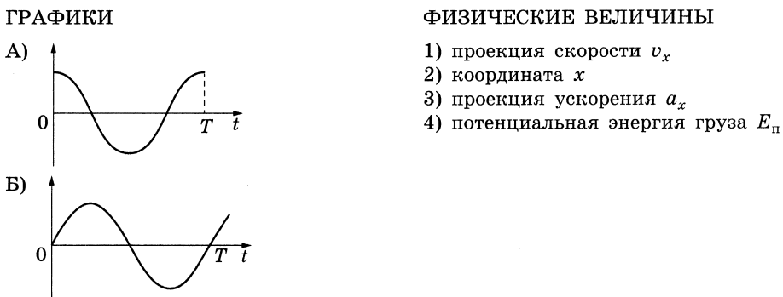


Slide 9

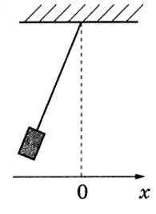



$$v=x^{′}\left(t\right)=x_{max}ω\sin\left(ωt\right)=v_{max}\sin\left(ωt\right);$$
$$a=v^{′}\left(t\right)=x_{max}ω^{2}\cos\left(ωt\right);$$
$$a=a_{max}\cos\left(ωt\right);$$
$$x=−x_{max}\cos\left(ωt\right);$$
$$3 1$$

Slide 10
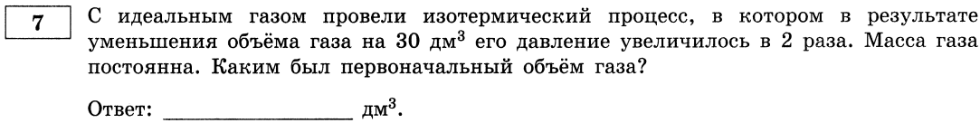
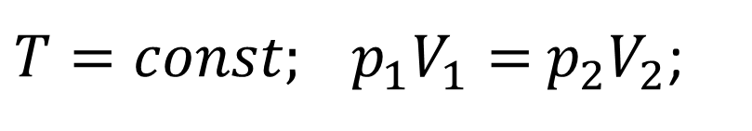



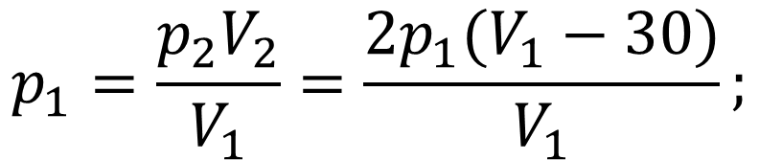
$$60$$
$$p_{1}=\frac{p_{2}V_{2}}{V_{1}}=\frac{2p_{1}(V_{1}−30)}{V_{1}};$$
$T=const; p_{1}V_{1}=$ $p_{2}V_{2}$;
$$V_{1}=2V_{1}−60;$$
$$V_{1}=60;$$

Slide 11
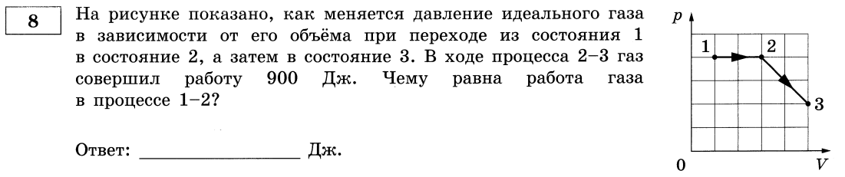
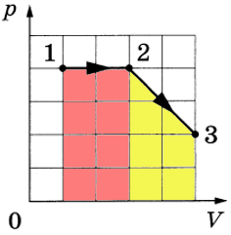

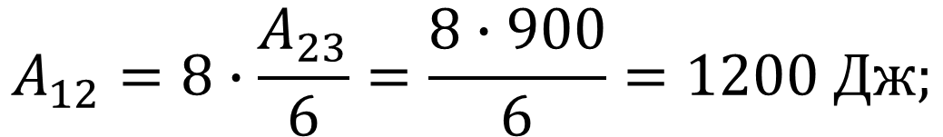
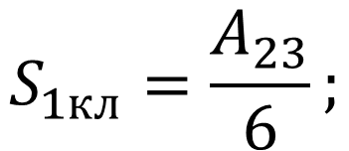


$$1200$$
$$S_{1кл}=\frac{A_{23}}{6};$$
$$A_{12}=8∙S_{1кл};$$
$$A_{23}=6∙S_{1кл};$$
$$A_{12}=8∙\frac{A_{23}}{6}=\frac{8∙900}{6}=1200 Дж;$$

Slide 12
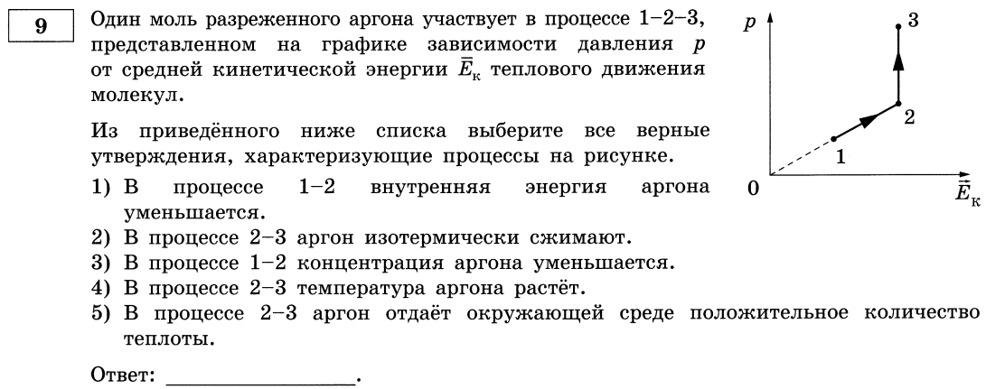
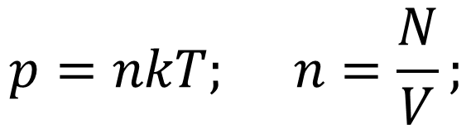


$${\overline{E}}_{k}=\frac{3}{2}kT;$$
$$p=nkT; n=\frac{N}{V};$$
$${\overline{E}}_{k}↗⇒U↗;$$
$$T=const⟹p↗V↘=const;$$

Slide 13
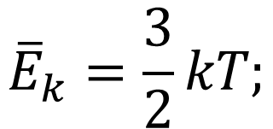


$${\overline{E}}_{k}=\frac{3}{2}kT;$$
$$Q=∆U+A; Q=A;$$
$$V↘⟹A<0⟹Q<0;$$

Slide 14
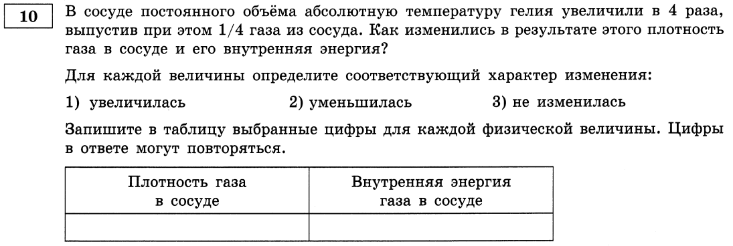

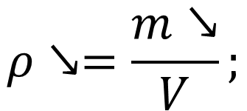
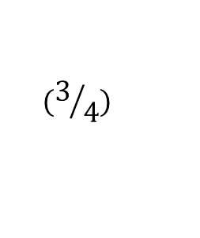

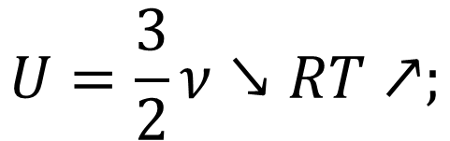

$$2$$
$$1$$
$$U=\frac{3}{2}ν↘RT↗;$$
$$ρ↘=\frac{m↘}{V};$$
$$(4)$$
$$(3/4)$$

Slide 15
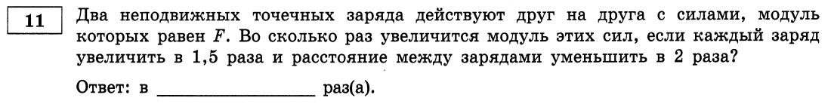
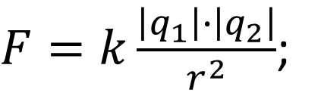

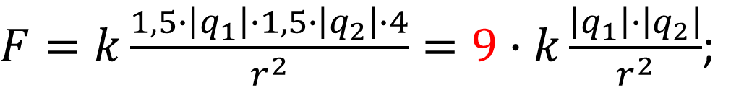
$$9$$
$F=k\frac{\left|q_{1}\right|∙\left|q_{2}\right|}{r^{2}}$;
$F=k\frac{1,5∙\left|q_{1}\right|∙1,5∙\left|q_{2}\right|∙4}{r^{2}}=9∙k\frac{\left|q_{1}\right|∙\left|q_{2}\right|}{r^{2}}$;

Slide 16
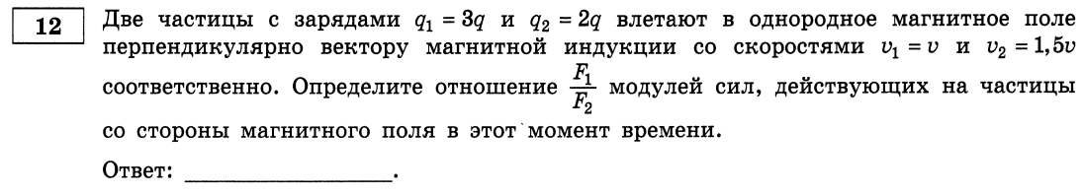
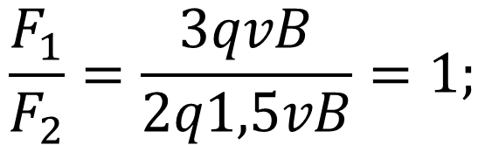

$$1$$
$$\frac{F_{1}}{F_{2}}=\frac{3qvB}{2q1,5vB}=1;$$

Slide 17
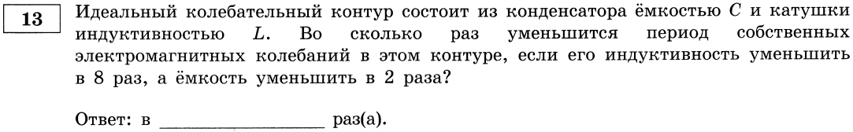


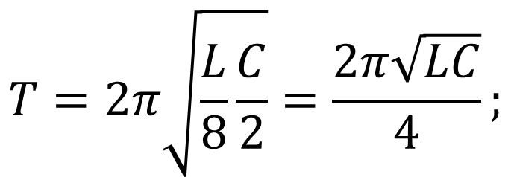
$$4$$
$$T=2π\sqrt{LC;}$$
$$T=2π\sqrt{\frac{L}{8}\frac{C}{2}}=\frac{2π\sqrt{LC}}{4};$$

Slide 18
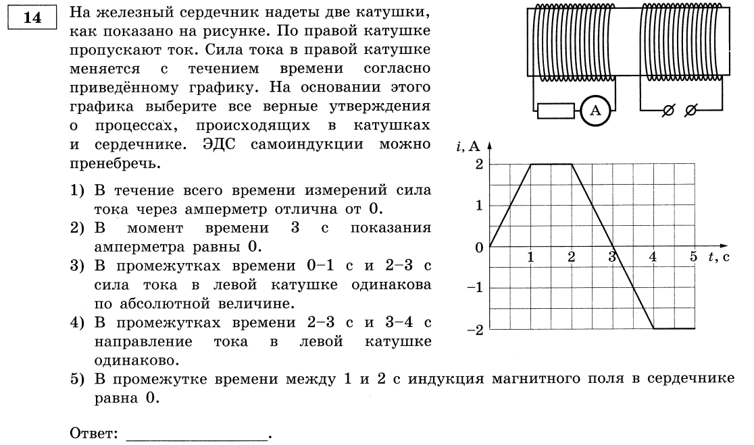

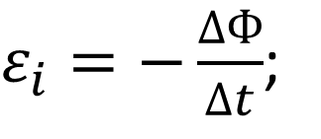
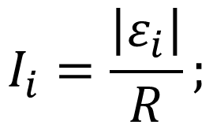
$$I_{i}=\frac{\left|ε_{i}\right|}{R};$$
$ε_{i}=−\frac{∆Ф}{∆t}$;
$$∆Ф=L∙\left|i\right|;$$

Slide 19
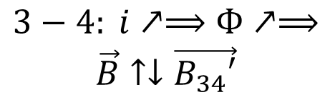
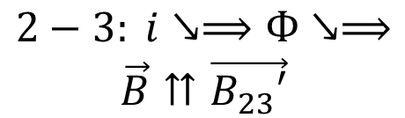
$$2−3: i↘⟹Ф↘⟹$$
$$\vec{B}⇈\vec{B_{23}′}$$
$$3−4: i↗⟹Ф↗⟹$$
$$\vec{B}↑↓\vec{B_{34}′}$$

Slide 20
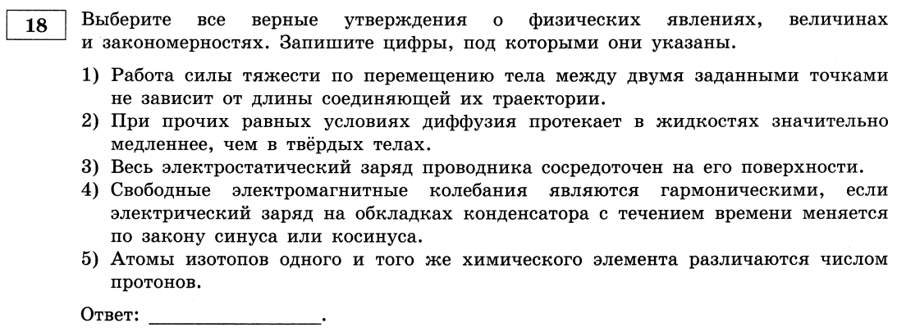

Slide 21
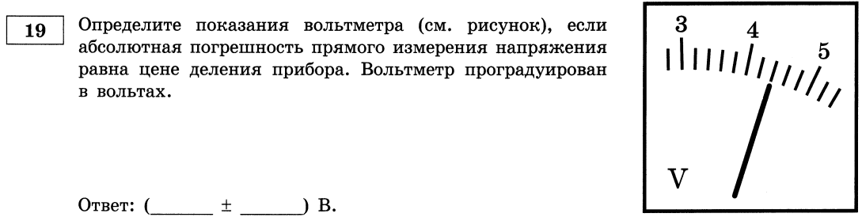


$$4,4$$
$$0,2$$

Slide 22
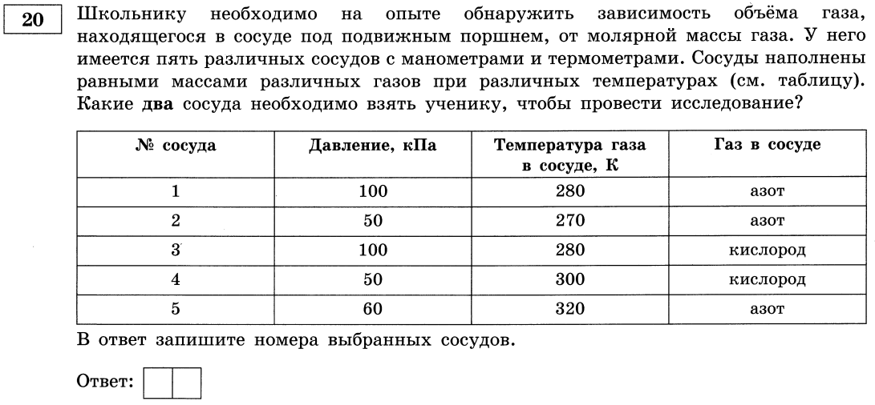

$$1 3$$

